Slide 1
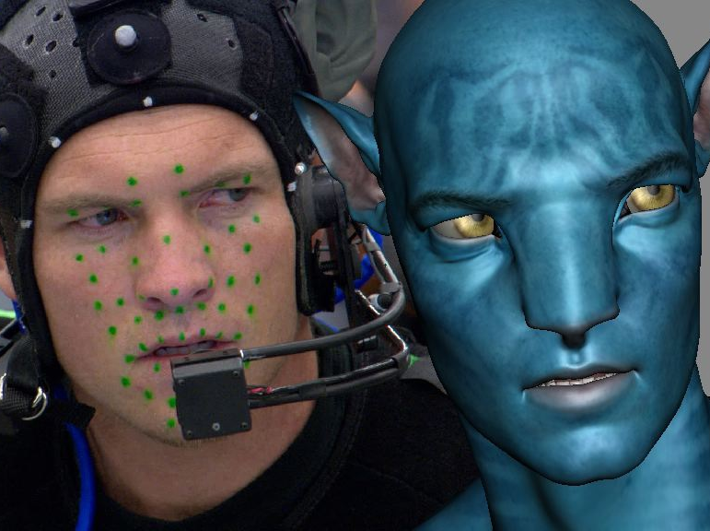
Advanced higher Graphic communication
Digital Visual Media Animation

Slide 2
Learning intentions & success criteria
Learning Intentions
Develop an understanding of the different animation techniques in AH graphics.
Success Criteria
State and explain the process of different animation techniques.
Explain the benefits and drawbacks of different animation techniques.

Slide 3
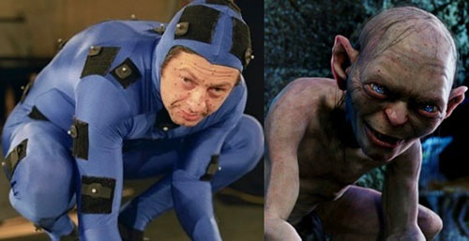
Motion capture
Motion capture involves the process of recording live motion events and translating it into actionable data that allows the recreation of the motion in a digital environment.
Optical motion capture requires the use of special markers, these markers are attached to a special suit and are easily identified by image processing software.
The actor Andy Serkis is well known for his motion capture rolls, e.g. Gollum in Lord of the Rings, Caesar in Planet of the Apes, King Kong and many more.

Slide 4
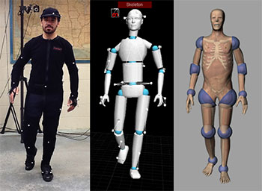
Motion capture advantages
Records the position and movement of the body accurately, the data captured could be used to make improvements to the scene or a product
Rapid/real time results can be achieved.
The data/ images captured could be used for promotional purposes
Provides data over the time duration that a product might be used
Records position and movement of parts of a product relative to the user, to check for ease of movement
Mechanical motion capture can provide data on the amount of force required to complete an action

Slide 5
Motion capture disadvantages
Large amount of data is generated that needs to processed and not all of it will be relevant
Expense of outsourcing the process or investing in specialist equipment and /or software, as well as trained staff
For product design, motion capture may have limited use as not all consumers will use a product in the same way
Specialist operator/interpreter required
Significant post processing operations required, requiring powerful processing power

Slide 6
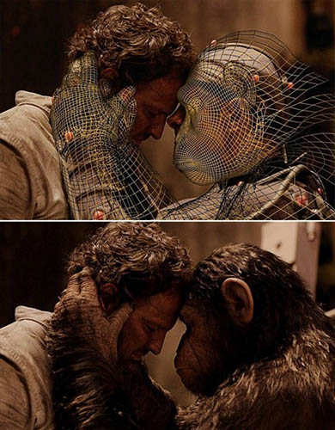
Motion capture
The benefits are that it is accurate, reliable but is expensive to set up and is time consuming.
The latest developments are in markerless motion capture using advanced computer vision technology that will identify and track subjects without the use of specialist suits.
The benefits of this latest technology are that there is an increase in accuracy and a reduction of set up time, reducing the overall costs.

Slide 7
https://www.youtube.com/watch?v=Rj0rXLEZWOg

Slide 8
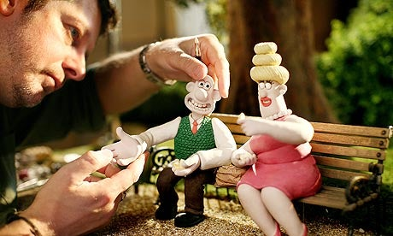
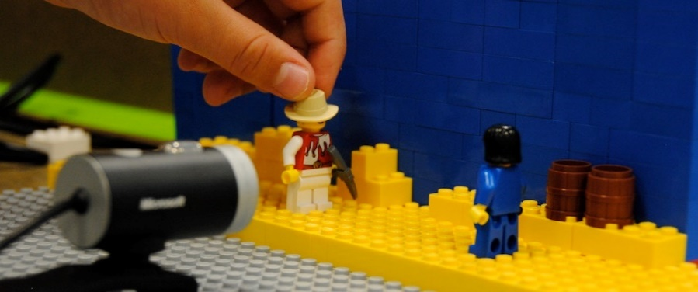
Stop-frame animation
Stop frame animation is a cinematic process or technique used to make static objects appear as if they are moving.
The process involves recording the position of an object (normally a photograph) then a small incremental change is made an new position is recorded.
Famous examples include Wallace and Gromit. Many people at home also create Lego animations using this technique and upload their films onto YouTube.

Slide 9
Stop frame animation
This process is repeated a number of times to create a sequence which when played back gives the illusion of movement.
Stop frame animation has a relatively low set up cost but is labour intensive and time consuming.
The film industry has been using this technique for decades. For example: Star Wars, Jason and the Argonauts and many other classic films featuring monsters. Some still use this technique, though many now turn to CGI to create special effects.

Slide 10
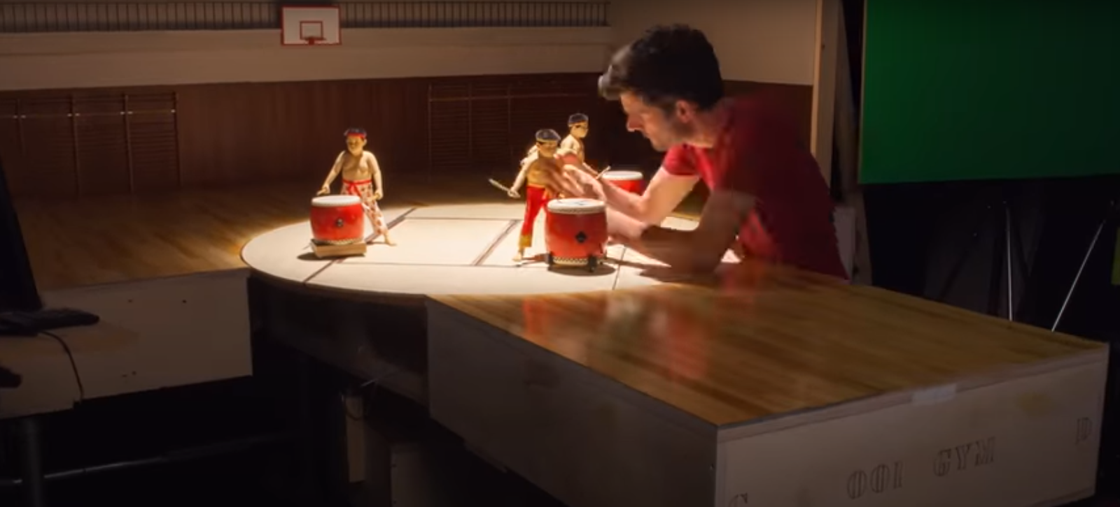
https://www.youtube.com/watch?v=wVjMFU11hVA
https://www.youtube.com/watch?v=dzibT_SjeoM

Slide 11
Motion tweening
Motion tweening is a process where the user defines the start and finish key frames and the system automatically calculates and creates the in-between frames.
This will then appear to move the shape over a specified distance within a specific period of time.
The benefits of this process is that it gives a smoother animation without the need to draw every frame, giving a quicker more cost effective animation.

Slide 12
https://www.youtube.com/watch?v=dvACVa8NVVA

Slide 13
Blend/fade
“Blending” and “fading” refers to the transition effect when a film/animation dissolves from one scene to another.
“Fade to black” is a common technique where a scene dissolves to total blackness. This helps soften the transition between scenes rather than simply cut from one scene to the next.
A blend can be used to dissolve two scenes together without first fading to black. This is useful as it can be used to convey a passage of time or separate parts of film/animation.

Slide 14
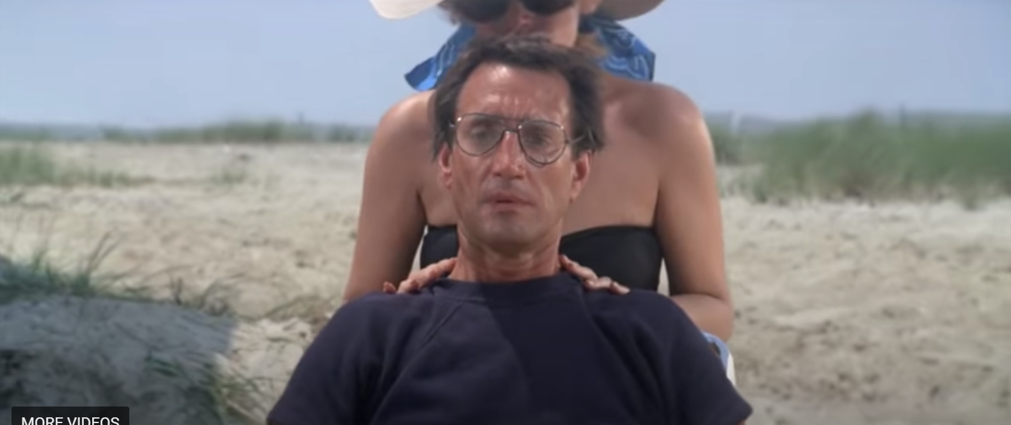
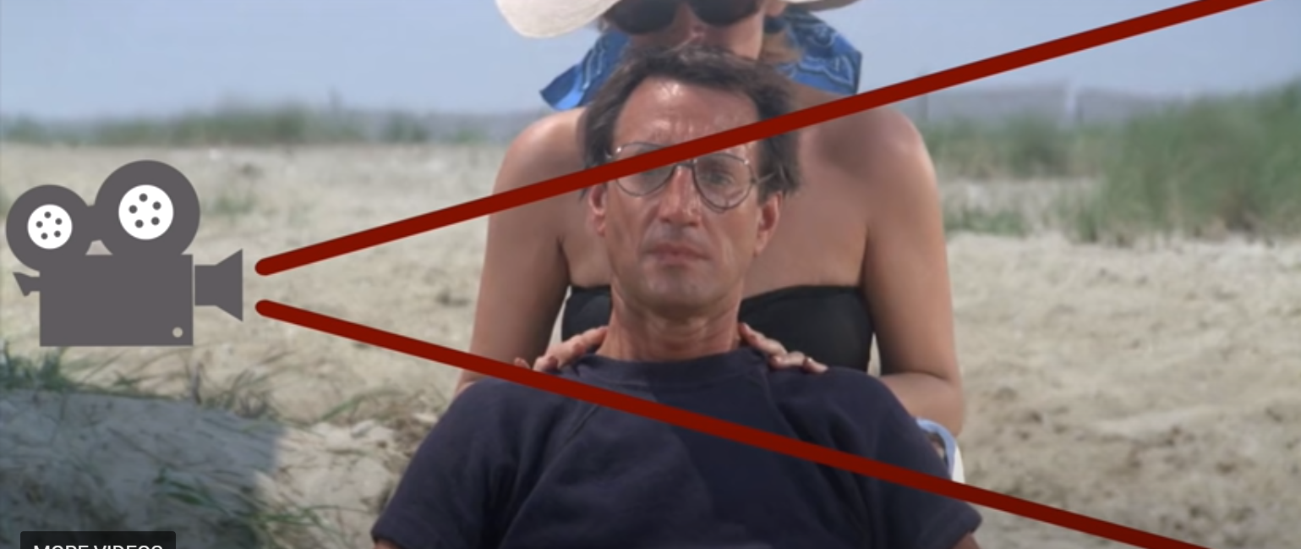
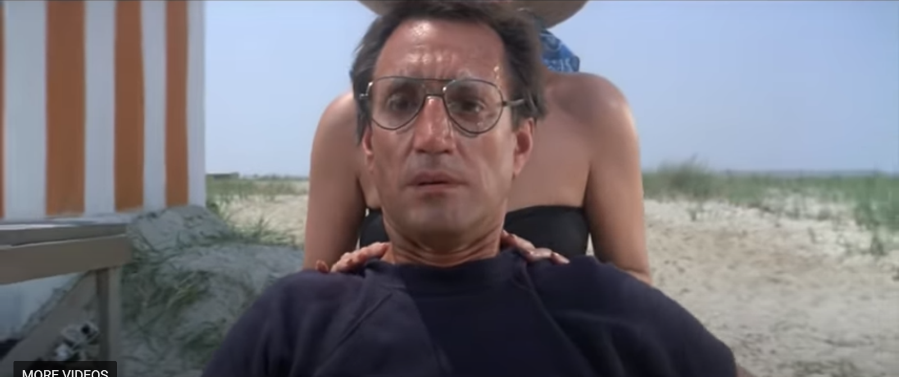
zoom
“Zoom” is similar to the term used in CAD software. It refers to enlarging or reducing the view of an object or scene.
Zoom can be used to focus in on a particular part of a scene to draw the viewers attention to it.
Inversely, “zooming out” will reduce the size of view for a scene, allowing the viewer to see more of a scene.
The speed of a zoom can be critical in creating an effect or mood. For example a very quick zoom-in can be used to really emphasise an object within a scene and create a dramatic or exciting mood.
A slower zoom-in will instead create a more relaxed mood.

Slide 15
Transition
Transitions are techniques used to combine scenes and shots. Fading and blending are examples of transitions. You may be familiar with transitions in PowerPoint.
Other transition techniques include: Wipe, Dissolve, Cut, Flip, Pan.
Star Wars famously uses “wipe” between scenes.
https://www.youtube.com/watch?v=cGqAu9gj_F0

Slide 16
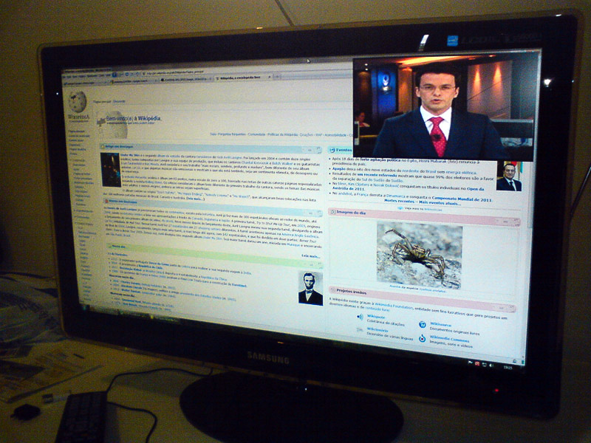
overlays
PIP (Picture in Picture) is when two or more video clips share the same display at the same time.
Text overlays – where static or moving written information is displayed on top of the video itself.
Image overlay – where an image is displayed on top of the video.
A combination of the above can also be used.

